Slide 1

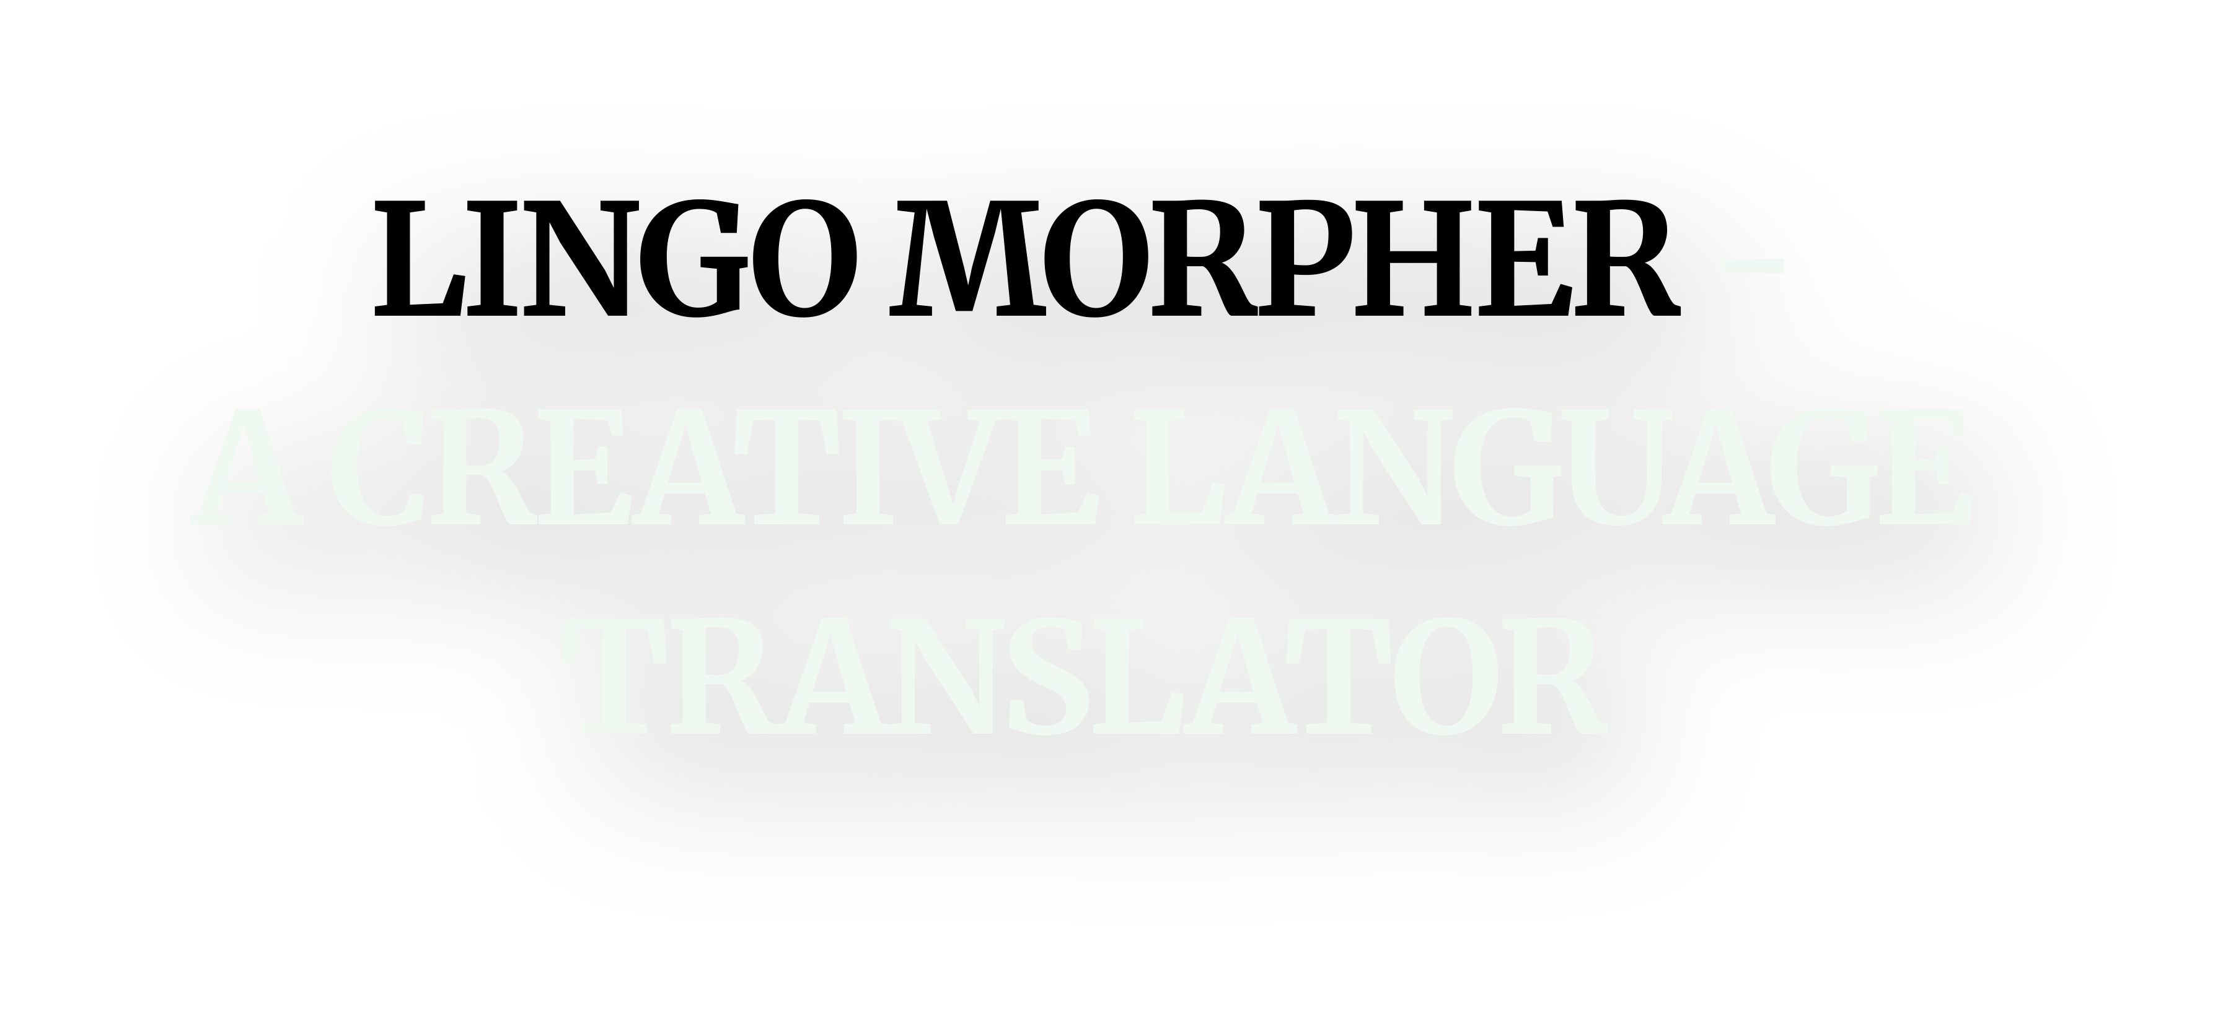

VIT CHENNAI
CODEZILLA
COMPANY NAME
07 AUGUST 2025
Team members: Trilochana Jayaraj Anagha Vandale Khushi Banjan

Slide 2
PROBLEM STATEMENT
Creative Language Translator
Context: Beyond literal translation, creative language tools can adapt tone and style. Generative AI can translate text while preserving nuance or even transform writing style (e.g., modern to Shakespearean). This hackathon challenge is to build an AI translator that maintains the original voice and style of the content.
Challenge: Develop an AI translation system that converts text between languages or writing styles while preserving meaning and tone

Slide 3
PROJECT OBJECTIVE
The objective of this project is to build a Creative Language Translator powered by Generative AI that goes beyond traditional word-for-word translation. This system is designed to understand and preserve the original tone, meaning, and style of input text while offering flexible output options that creatively transform the content.
Unlike basic translators, this tool enables users to not only translate between languages, but also to:
Convert prose into poetry, quotes, song lyrics, or essays
Adjust the tone of the text from very casual to very formal
Choose the style or format of the output based on their context or audience
By combining natural language understanding with stylistic transformation, the project aims to provide a powerful solution for users who want creative control over how their content is presented across languages and tones.

Slide 4
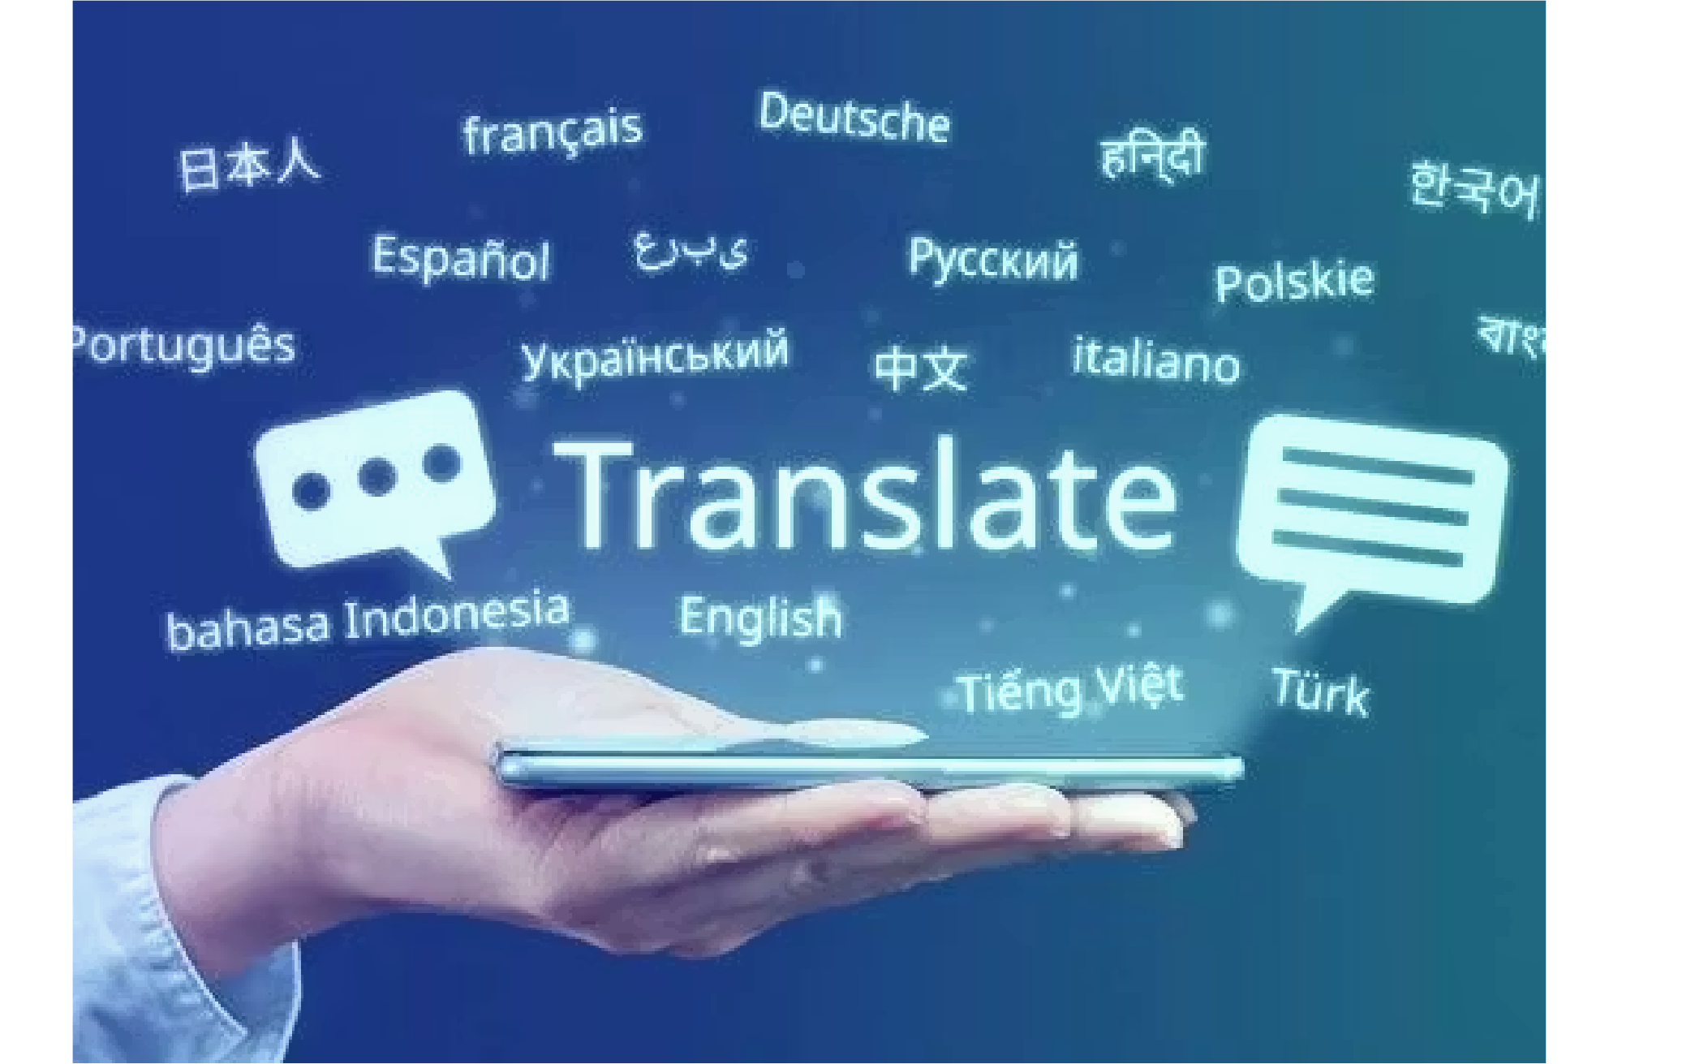
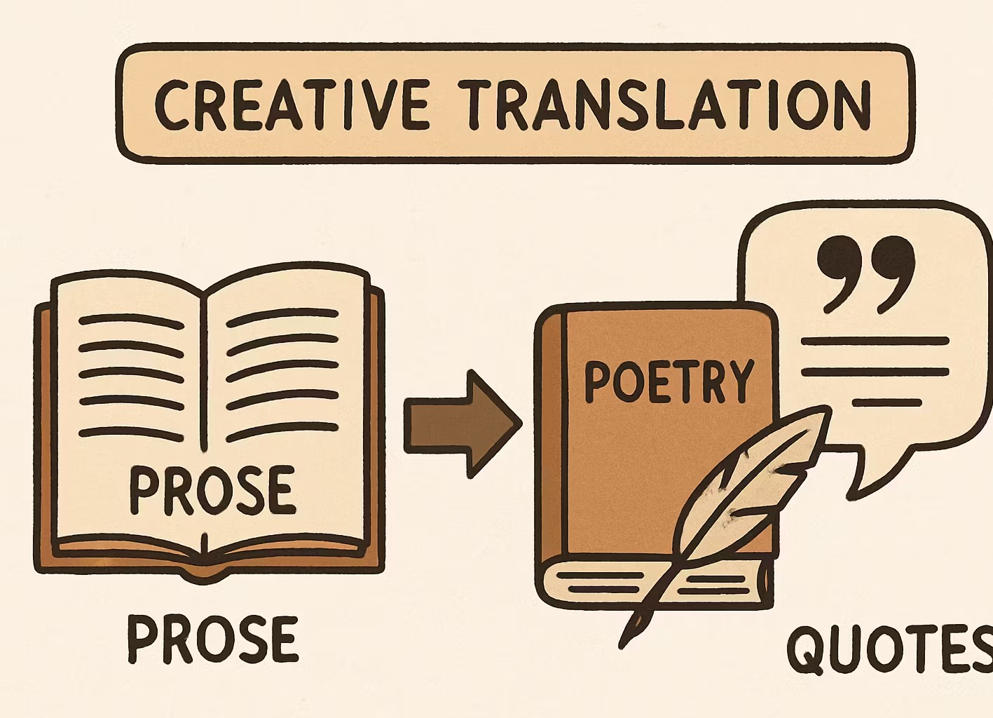
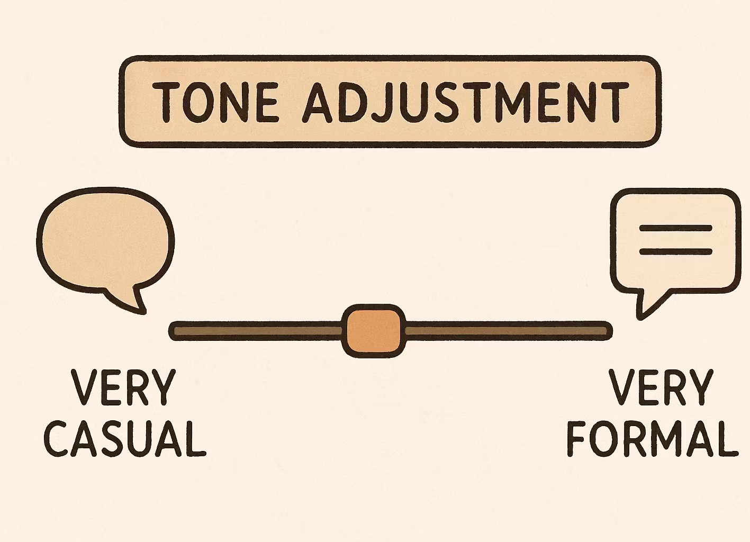
KEY FEATURES
COMPANY NAME
07 AUGUST 2025
Translation Options
Translate among Hindi, English, and Tamil creatively.
Creative Translations
Convert prose into poems, songs, quotes, and essays.
Tone Adjustment
Adjust text tone from very casual to very formal.

Slide 5
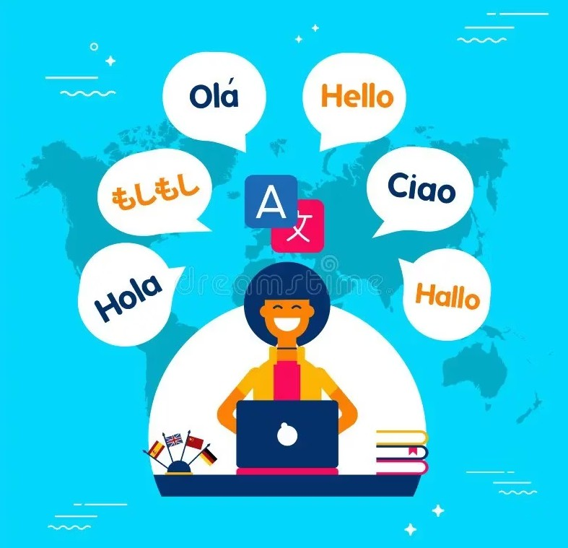
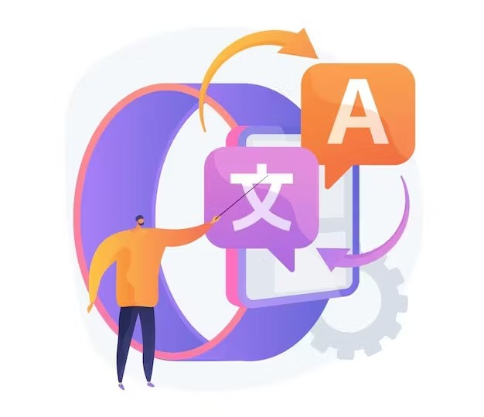
LANGUAGE TRANSLATOR
This project is a smart and efficient Language Translator designed to convert text from one language to another while preserving its original meaning and clarity.
Includes languages like English, Hindi and Tamil.
Maintains the tone, structure, and meaning of the original content.
The Main Objective:
To develop a simple, fast, and effective tool that allows users to:
Translate written content between languages.
Understand and preserve the intent behind the original message.

Slide 6
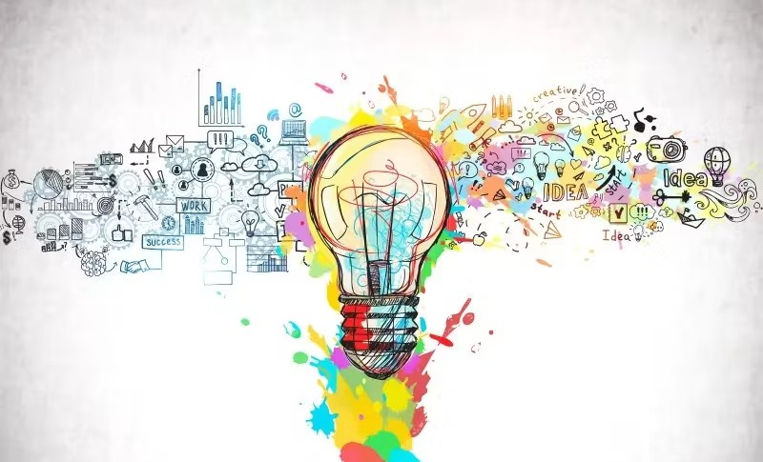
CREATIVE TRANSLATOR
The Creative Language Translator is an AI-powered tool that goes far beyond traditional translation.
Instead of simply converting text between languages, it is designed to reimagine and recreate content in various creative formats such as:
📜 Poetry
🎵 Song Lyrics
💬 Quotes
📝 Essays and many more
It understands not just the language, but also the tone, emotion, context, and intent behind the text. It then reconstructs the content in a new form — artistic, meaningful, and audience-appropriate.
The Main Objective:
Rewrites user-provided prose
into a selected creative format.
Preserves the core meaning while enhancing expressiveness and emotional impact.

Slide 7
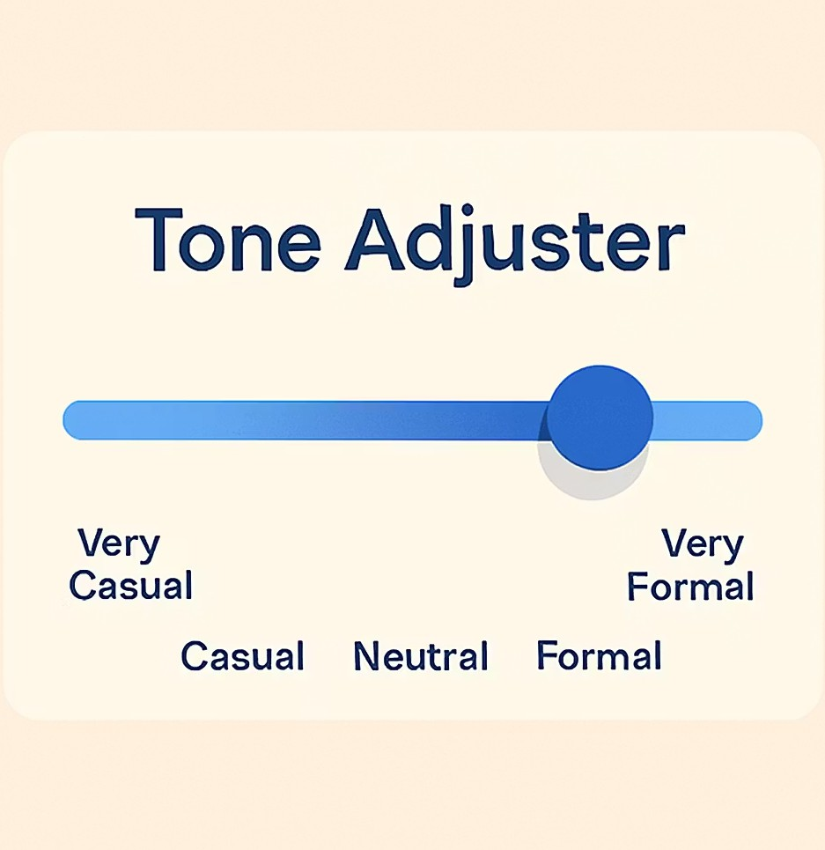
TONE ADJUSTER
The Tone Adjustment feature in the Creative Language Translator allows users to modify the tone and formality level of their input prose.
Instead of changing just the words, it intelligently transforms the writing style, structure, and vocabulary of the given prose to align with a selected tone — from very casual to very formal.
The Main Objective:
To enable users to dynamically control the formality and tone of their text—ranging from very casual to very formal—while preserving the original meaning, so that the output aligns with the target audience, context, and purpose of the communication.

Slide 8
OUTPUT SAMPLES AND DEMONSTRATION
Input Output
01
"The old woman lived alone in a small cottage at the edge of the woods. She spent her days tending her garden and talking to the birds. One day, a young girl stumbled upon her cottage, lost and frightened
An old woman, all alone,
In a small cottage, made her home.
It stood at the edge of woods so deep. Her quiet days, she'd gently keep: Tending the garden, green and wide, And talking to birds, by her side.
One day, a young girl, lost and afraid, Upon her cottage, stumbled, dismayed.
02

Slide 9
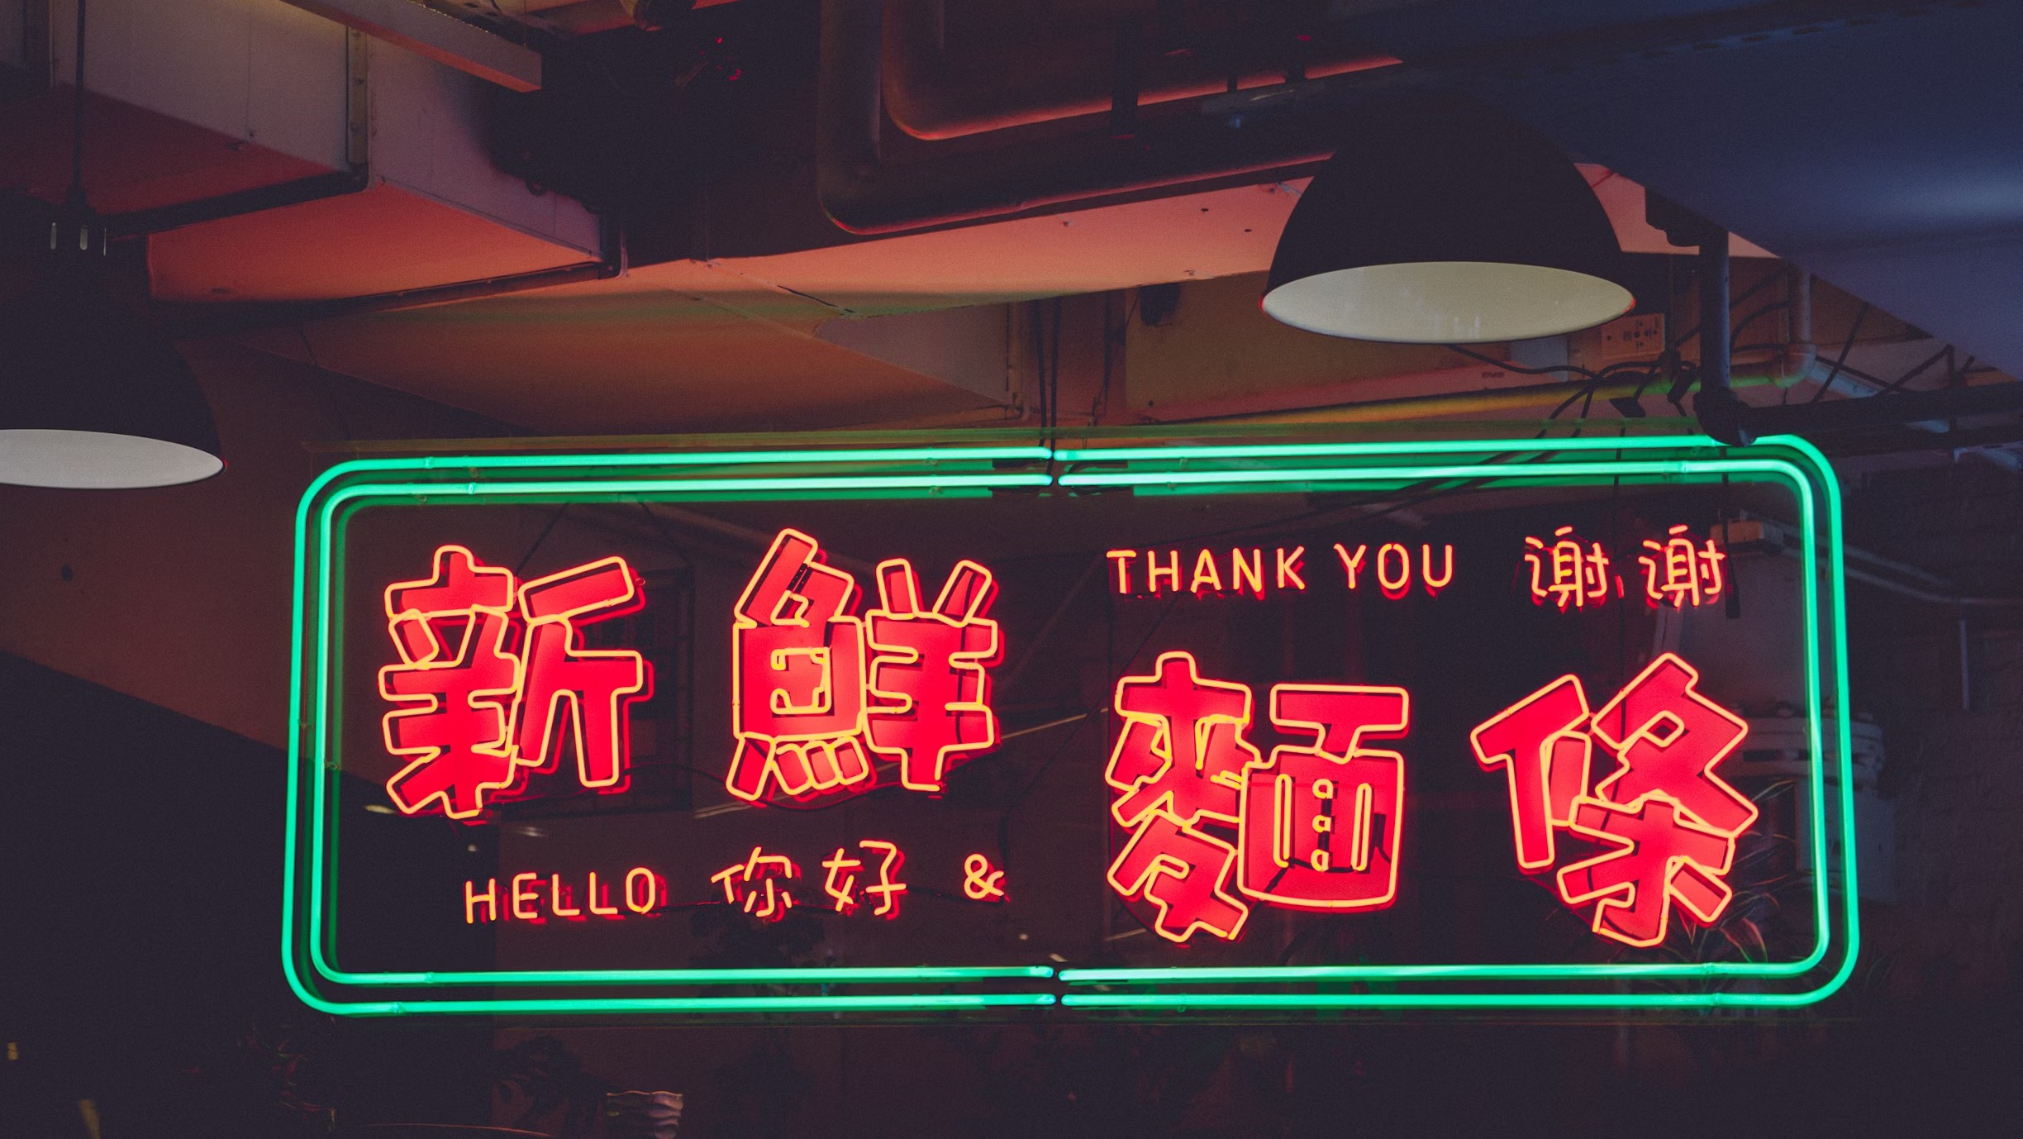
ORIGINALITY PRESERVED
COMPANY NAME
07 AUGUST 2025
Accuracy Assurance
In the realm of translation, the essence lies in maintaining the authenticity of the original text in every aspect. Our project ensures the preservation of meaning, tone, and voice with utmost accuracy, delivering an unparalleled experience.

Slide 10


COMPANY NAME
07 AUGUST 2025
REVOLUTIONIZING LANGUAGE TRANSLATION WITH CREATIVITY

Slide 11
CONCLUSION
We built a Creative Language Translator that goes beyond literal translation.
The system transforms input text into poems, quotes, lyrics, or essays, and adjust tone from
very casual to very formal.
Our focus was on preserving meaning, tone, and style, while giving users flexible creative control over the output.
Supports multiple creative formats.
Provides tone-level control through an adjustable slider.
Enhances communication, personalization, and expression.
With this project, we aim to redefine how translation works — not just by changing words, but by transforming the voice, tone, and soul of the content.

